Slide 1

Stage 4 I Hate My Life And You’re Gonna Hate It Four Course Designer: Marcel Englmaier and Eric Beerbaum
I Hate My Life And You’re Gonna Hate It Four is a 24 round, 120 point Standards Exercise. There are 6 USPSA targets. The best 4 hits per target will score. The start signal is audible.
The Handgun start position is standing anywhere in the shooting area with wrists below belt. Handgun is loaded and holstered. The PCC start position is standing anywhere in the shooting area with PCC loaded, stock on belt, safety on.
String 1: On the audible start signal, engage all targets with 1 shot each freestyle, perform a mandatory reload, then engage all targets with one shot each Strong Hand Only. String 2: On the audible start signal, engage all targets with 1 shot each freestyle, perform a mandatory reload, then engage all targets with one shot each Weak Hand Only.

Slide 2
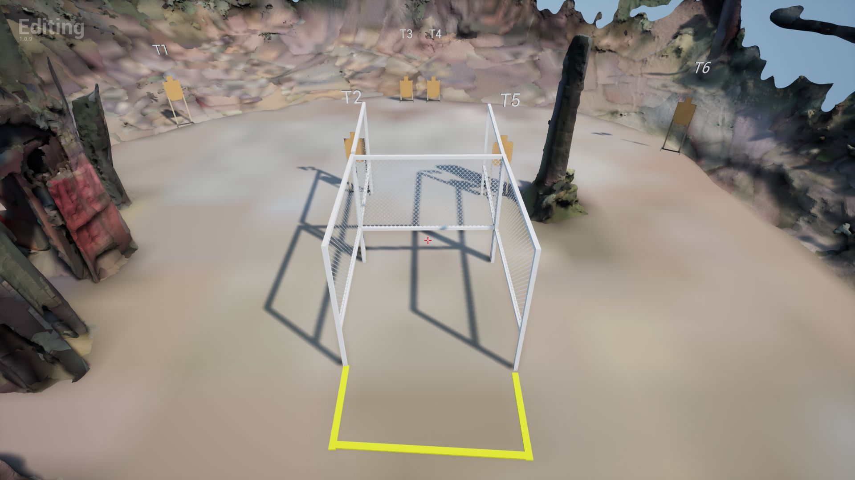
 | Stage 4 I Hate My Life And You’re Gonna Hate It Four Course Designer: Marcel Englmaier/Eric Beerbaum

